Slide 1
Types of Poems
Grade 8

Slide 2
Haiku
The Haiku is a form of verse invented in Japan centuries ago. The English interpretation of the Japanese haiku is three short lines of five, seven, and five syllables respectively.
The words speak of a mood, a strong feeling, or an atmosphere. Although the poem is usually about nature, a person’s thoughts and emotions are often included.
The magic of a good haiku lies in the power of suggestion. The general purpose of a haiku is to present one simple observation, and no more. But this one visual image creates a tension designed to make the reader think.

Slide 3
Example of a Haiku
Life Lesson
by Don Raye
The firce wind rages
And I see how trees survive –
They have learned to bend

Slide 4
Cinquain
The Cinquain is a short, usually unrhymed poem consisting of twenty-two syllables. The first line has two syllables, the second line has four syllables, the third line has six syllables, the fourth line has eight syllables, and the fifth line ends the poem with two syllables.
This form offers more than a simple syllabic arrangement, there is an elastic effect to it. This startling factor throws the poem into harsh relief –the short last line with only two syllables makes a noticeable impact.

Slide 5
Example of a Cinquain
Similarities
by Anonymous
I touch
Two curving things:
The barrel of this pen,
The tragic, slow unwindings of
This verse.

Slide 6
Tanka
The Tanka is another Japanese form of poem –almost like an extension of the haiku. The tanka adds two lines to the haiku, each of seven syllables. Thus it has five lines of thirty-one syllables used in the following way:
Line 1: five syllables
Line 2: seven syllables
Line 3: five syllables
Line 4: seven syllables
Line 5: seven syllables
Like the haiku, the Tanka typically deals with a season of the year. Depth of meaning and striking imagery are of great importance in the Tanka.

Slide 7
Example of a Tanka
Adversity
by Don Raye
Debris in the wind
Indiscriminately blinds
Eyes searching a path
To turn one’s back to the wind
Reveals but where one has been

Slide 8
Diamante
A Diamante is a simple diamond-shaped poem expressing contrast. It may have any number of lines. The first line contains one word, the second line two, the third line three and so on until the middle line which introduces an idea opposite to the idea developed in the lines up to that point. Each line following the middle line decreases by one word until the last line which consists of the direct opposite of the opening word.
In a seven-line Diamante, each of the following steps represents one line f the poem:
one noun
two adjectives describing the noun
three participles (words that end in –ing or –ed) pertaining to the noun
four nouns related to the subject (*the second two nouns have meanings opposite to the first two)
three participles indicating change or development of the subject noun
two adjectives carrying on the idea of change or development
A noun that is opposite to the original noun

Slide 9
Example of a Diamante
From Grief Comes Joy
by Unknown
Joy
Frisky, buoyant
Warming, sparkling, reveling
Nonsense, comedy – witchery, absurdity
Haunting, piercing, confusing
Doubtful, lonely
Grief

Slide 10
Free Verse
Free Verse is an irregular form of poetry in which the content is free of traditional rules of versification, (freedom from fixed meter or rhyme). In moving from line to line, the poet's main consideration is where to insert line breaks. Some ways of doing this include breaking the line where there is a natural pause or at a point of suspense for the reader. Following the direction of Walt Whitman, Ezra Pound and T.S.Eliot, many modern day poets use this particular form of expression.

Slide 11
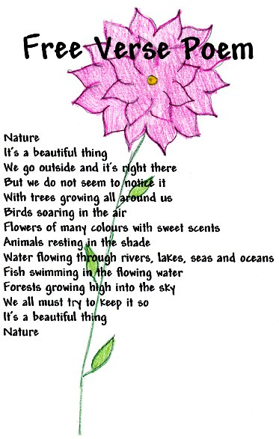
Example of Free Verse

